Slide 1
Stable Matching and Orderly Markets
Medical Residents, Law Clerks and College Admissions

Slide 2
Today’s Class
Last time: introduced the basic model of two-sided matching and idea of stable matching.
Today: discuss organization of matching markets in practice, using examples.
  Clearinghouses and decentralized markets
  Problem of unraveling in matching markets
  Forces that lead matching markets to clear in ways that are more or less orderly and efficient.

Slide 3
From Theory to Practice
Study of matching started as “pure” theory: first by David Gale and Lloyd Shapley (1962) who introduced DA algorithm, then others, eg Stanford prof Donald Knuth.
In 1984, Al Roth made a surprising discovery:
  Since the 1950s, US hospitals have used a clearinghouse to assign graduating medical students to residencies.
  Students apply and interview at hospitals in the fall, then students and hospitals submit rank-order preferences in February.
  A computer algorithm is used to assign students to hospitals, and matches are all revealed on a single day: match day.
  Roth realized that the doctors has independently discovered and were using exactly the Gale and Shapley DA algorithm!

Slide 4

Match Day

Slide 5
History of NRMP
History turns out to be illuminating
  Into the 1930s, medical students found residencies through a completely decentralized process.
  But there were problems: students and hospitals made contracts earlier and earlier, eventually in second year of med school!
Hospitals decided to change the system by adopting a centralized clearinghouse.
  National Residency Matching Program (NRMP) adopted, after various adjustments in 1952.
  System has persisted, though with some modification in late 1990s to handle couples and some recent debate about salaries.
Why might a centralized clearinghouse be useful? And how might the design of the clearinghouse matter?

Slide 6
Stability and Orderly Markets
Some hypotheses to consider:
  Centralized clearinghouse can lead to more “orderly” market than decentralized (eg clinical psychology)
  Designing a clearinghouse to achieve a stable match might discourage re-contracting, or pre-contracting.
How could one test these hypotheses?
  Compare DA to alternative matching process.
  Compare centralized markets to decentralized.
  Ideally, with some sort of experiment (lab? natural?)

Slide 7
Priority matching
Men and women submit their preferences.
  Each man-woman pair gets a priority based on their mutual rankings.
  Algorithm matches all priority 1 couples, takes them out of the market.
  New priorities are assigned and process iterates.
Example of priority assignment:
  Assign priority based on product of the two rankings, so that priority order is 1-1, 2-1, 1-2, 1-3, 3-1, 4-1, 2-2, 1-4, 5-1, etc…
  Algorithm implements all “top-top” matches, then conditional top-tops, etc. When none remain, look for 2-1 matches, etc.
Compare this to DA: will priority matching lead to a stable match? Should people be honest or strategic about their preferences?

Slide 8
Example
Preferences of men and women
m1: w1 > w2 > w3 | w1: m2 > m1 > m3
m2: w2 > w3 > w1 | w2: m1 > m3 > m2
m3: w2 > w1 > w3 | w3: m1 > m2 > m3
Find the unique stable matching.
Find the outcome under priority matching with order
  1-1, 2-1, 1-2, 1-3, 3-1, 2-2, 2-3, 3-2, 3-3

Slide 9
Priority Matching Example
Three men, three women with rankings
  m1: w1 > w2 > w3 w1: m2 > m1 > m3:
  m2: w2 > w3 > w1 w2: m1 > m3 > m2
  m3: w2 > w1 > w3 w3: m1 > m2 > m3
Unique stable match: (m1, w1), (m2, w3), (m3, w2)
Priority order is 1-1, 2-1, 1-2, 1-3, 3-1, 2-2, 2-3, 3-2, 3-3.
  No top-top matches, first match is: (m1, w2).
  Removing m1, w2, top-top match is: (m2, w3)
  Which leaves: (m3, w1).
Not stable, and m1 could list w2 last and get w1.. (check!).

Slide 10
Failure of priority matching
Roth (1991, AER) studied residency matches in Britain, which are local and have used different types of algorithms --- a “natural experiment”.
Newcastle introduced priority matching in 1967.
  By 1981, 80% of the preferences submitted contained only a single first choice.
  The participants had pre-contracted in advance!
This is the type of “market unraveling” that plagued the US residency market prior to the NRMP.
We’ll have more to say about unraveling later.

Slide 11
Success of stable mechanisms
Market |  | Algorithm | Still Used?
NRMP |  | DA | yes
US Medical Specialties (about 30) |  | DA | yes*
UK Residency matches (Roth, 1991)
 | Edinburgh | DA | yes
 | Cardiff | DA | yes
 | Birmingham | Priority | no
 | Newcastle | Priority | no
 | Sheffield | Priority | no
 | Cambridge | Priority | yes
 | London hospital | Priority | yes
Canadian lawyers |  | DA | yes*
Pharmacists |  | DA | yes
Reform rabbis |  | DA | yes

Slide 12
Stability and Market Participation
Starting in the 1970s, an increasing number of couples graduated from medical school.
  Typically couples want to be in the same city, but the DA algorithm doesn’t account for this; it might put a husband in Boston and wife in Chicago.
  So many couples started to go around the NRMP to find positions where they could be at the same hospital – match was threatened by a new form of unraveling.
NRMP realized there was a problem and eventually asked Al Roth to re-design the match.

Slide 13
Couples: a problem!
Couple c1,c2 and single student s
Two hospitals, each hiring one student
  Hospital 1: c1, s
  Hospital 2: s, c2
  Single student: H1, H2
  Couple: (H1, H2) or nothing.
There is no stable match!

Slide 14
Instability with Couples
Preferences
Hospital 1: c1, s
Hospital 2: s, c2
Student: H1, H2
Couple: (H1, H2), ∅
Assign one member of couple?
Couple will block
Assign (H1,c1),(H2,c2)?
H2 + s will block
Assign (H1,s)?
Couple + hospitals block
Assign (H2,s)?
s + H1 will block

Slide 15
Couples in the DA
Preferences
Hospital 1: c1, s
Hospital 2: s, c2
Student: H1, H2
Couple: (H1, H2), ∅
Round 1
H1 → c1, H2 → s
c1 rejects, s holds
Round 2
H1 → s, s rejects H2
Round 3
H2 → c2, who rejects.
End state: (H1, s) match.

Slide 16
Couples in the DA
Preferences
Hospital 1: c1, s
Hospital 2: s, c2
Student: H1, H2
Couple: (H1, H2), ∅
Round 1
c → H1,H2, s → H1
H1 rejects s
Round 2
s → H2
H2 rejects c2
c1 withdraws from H1
End state: (H2, s) match.

Slide 17
Re-Design of the NRMP
No “clean” solution to the couples problem.
  Student-proposing perhaps a bit better => switch from hospital to student proposing version of DA.
  What if DA algorithm doesn’t find a stable match? Perturb the algorithm and keep going.
  Not guaranteed to find a stable match, but seemed to work in simulations (and “large” mkts).
These theory-guided “fixes” brought couples back into the match, stopping the unraveling.

Slide 18
The NRMP as a Case Study
NRMP is an unusual but illuminating design of a matching market because it is so organized.
  Motivation for moving to a clearinghouse was unravelling (i.e. disorderly operation) of decentralized matching.
  Design of the clearinghouse evidently quite important: systems with unstable matching seem to have fared poorly.
Next, let’s consider some comparable markets with different approaches to matching and see whether and how these insights might extend.

Slide 19
Law Clerk Market
Students graduating from law school seek positions with federal or state judges (Avery et al., 2001).
  A similar story of unraveling: market for clerkships to start in July/August 2003 cleared in September 2001.
  Market is thin, fast and chaotic, with judges frequently making exploding offers with short deadlines.
Attempts to enforce hiring dates and rules (there have been many) have not worked well.
  In March 2002, Judicial Conference agreed to a one-year hiring moratorium, with hiring for Fall 2004 to start in Fall 2003. Moratorium was okay, but the start date was tricky…

Slide 20
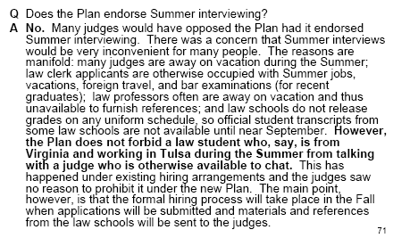
From the plan announcement..

Slide 21
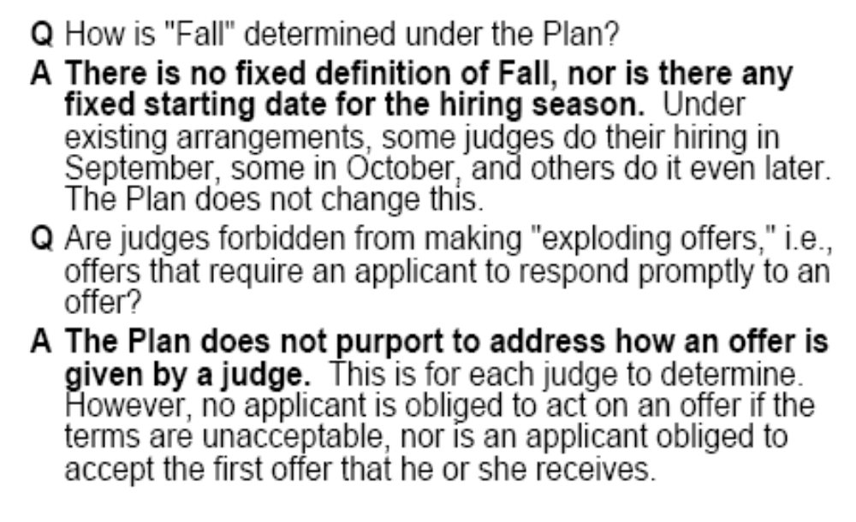
From the plan announcement

Slide 22
Unraveling of Fall Deadline
Open letter from Stanford Law Dean Larry Kramer, June 19, 2012
As you know, the Law Clerk Hiring Plan establishes dates in September before which federal judges are not supposed to interview or make offers to rising third-year law students. Law schools, for their part, are supposed to “discourage” students from applying before those dates and to “discourage” faculty members from supporting students who nonetheless do so. When the Plan was created, and for many years after, the vast majority of judges abided by its terms, providing order and equal access to federal judicial clerkships.
In recent years, that order and access has eroded. Increasing numbers of judges—the entire membership of some courts, some or many of the judges in most others—have begun interviewing and hiring law clerks well before the Plan dates. Law schools, understandably anxious not to disadvantage their students, have accommodated these early moving judges. Without making explicit or formal institutional announcements, schools have looked the other way while permitting or even tacitly encouraging faculty members to contact and correspond with early moving judges on behalf of their students.
Put in other words, the Plan is not actually being followed, resulting in a process that is inequitable and unfair. Students who are “in the know”—because they are members of the right student organization or on the right journal or have the right faculty mentor—learn which judges are accepting early applications and get support. Those lucky enough to have connections to judges and/or faculty members are able to apply and secure clerkships, while others, less fortunate, are not.

Slide 23
Exploding offers
“I received the offer via voicemail while I was in flight to my second interview. The judge actually left three messages
  First, to make and offer.
  Second, to tell me that I should respond soon
  Third, to rescind the offer.
  It was a 35 minute flight.
“I had 10 minutes to accept”
“I asked for an hour to consider the offer. The judge agreed; however thirty minutes later [the judge] called back and informed me that [the judge] wanted to rescind my offer.”

Slide 24
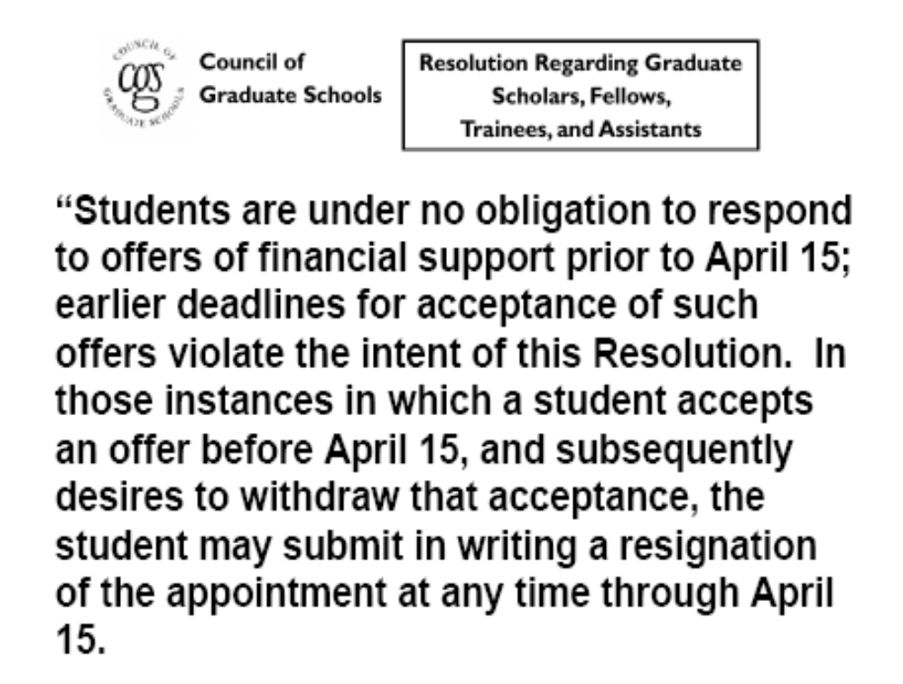
Addressing exploding offers

Slide 25
Market Unraveling
The residency and law clerk markets are two examples of markets that have unraveled – clearing of the market has shifted earlier and earlier.
Many matching markets, especially with fixed appointment dates, have suffered from this problem.
  Medical fellowships
  Judicial clerkships
  College admissions
  College football bowls
  High school prom
  NBA/NCAA basketball recruiting
  Baseball free agency
  Political campaigns/primaries
We’ve already touched on why this might happen.
Does it create inefficiencies? How so?

Slide 26
Gastroenterology Fellowships
Doctors completing residencies often continue training for 2-3 years as specialized fellows.
Many fellowships, but not all, have adopted versions of the NRMP matching system.
The gastroenterology fellowship is particularly interesting because in the mid-1990s the match collapsed, and only recently re-started.
  Opportunity to do a “before and after” study of the effect of a centralized clearinghouse in an entry-level labor market.

Slide 27
Collapse of GI Match
 | Posts withdrawn (%) | Posts in Match | Percent Matched | Applicants per position
1992 | -- | 377 | 97 | 1.8
1993 | -- | 399 | 94 | 1.6
1994 | -- | 369 | 93 | 1.6
1995 | 4 | 337 | 89 | 1.3
1996 | 5 | 298 | 75 | 0.9
1997 | 16 | 213 | 85 | 1.1
1998 | 44 | 99 | 78 | 1.5
1999 | 60 | 14 | -- | --

Slide 28
What happened?
Key event may have been 1996 study in JAMA stating that there are “too many” GI docs, and calling for 25-50% reduction in fellowships that programs then endorsed.
Following this, both sides appear to have felt that they were on the short side of the market -- although it seems demand for positions did not actually fall off.
After the match died, interesting changes
  Market became early and very rushed
  Matches were made “locally”

Slide 29
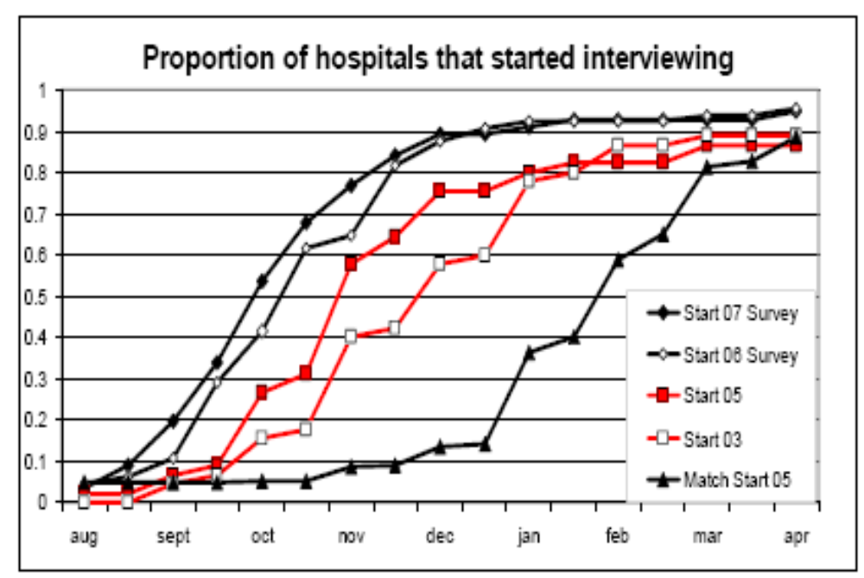
Unraveling of Interviews

Slide 30
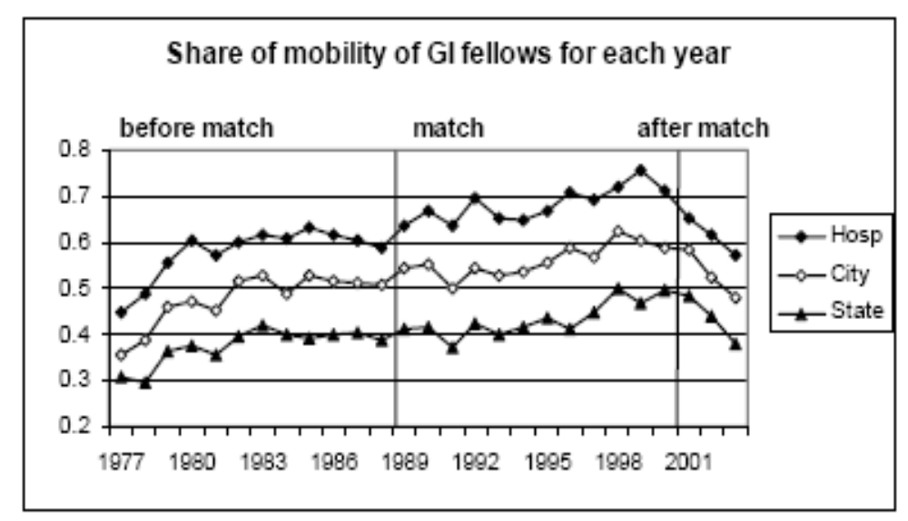
Local Matches

Slide 31
Some tentative conclusions
Decentralized markets with fixed appointment dates can have timing issues that may create problems
  Employers and workers may have an incentive to “jump the gun” in order to ensure a match or a good match.
  Employers may be hesitant to leave offers outstanding, and may want to use “exploding” offers to rush decisions.
  The market can clear in a disorderly fashion so that participants end up with a relatively limited set of choices.
These issue potentially can translate into inefficient matching, although we have not seen much evidence to quantify the benefits of an orderly market.

Slide 32
College Admissions
College admissions in US is decentralized but organized in a relatively precise fashion – schools often use common application & set common deadlines.
Practice of early admissions is a somewhat controlled form of market unraveling.
  Students generally can target one school with an early application, and admission may or may not involve commitment to attend (early decision versus early action).
Most selective schools offer early admissions - 30 of 38 “most selective” US universities, and 24 of 25 “most selective” liberal arts colleges.
Notes:
32
Since first FCC auction in 1994, hundreds of billions of dollars of radio spectrum allocated by auction.

Slide 33
The Early Admissions Debate
Adoption of early admissions & controversy
  Large number of schools adopted early admissions in the 1980s-90s, as admissions was becoming more competitive.
  Early admit rates can be double regular ones; EA perceived as unfair to less sophisticated students.
Could there be benefits to early admissions?
  Allows students to communicate information & enthusiasm - a “credible signal” (Avery-Levin, AER).
  Potentially limits the number of applications students have to prepare and colleges have to evaluate (transaction costs).
But there also is considerable evidence that schools face competitive pressure to use these programs.

Slide 34
Dropping Early Admissions?
From the New York Times, February 24, 2011
Princeton and Harvard Reinstate Early Admissions
By CATHERINE RAMPELL
A real-life allegory on the perils of unilateral action: First Princeton tried to be the leader on grade deflation, but no one followed. Then Harvard and Princeton decided to end their early admission programs, on the grounds that they were unfair to economically disadvantaged students. Again, apparently few schools followed suit.
[Quoting from the] Daily Princetonian: Tilghman explained that one consideration that played into the University’s decision was that high school students would apply to other schools early even if they thought of the University as their first choice.

Slide 35
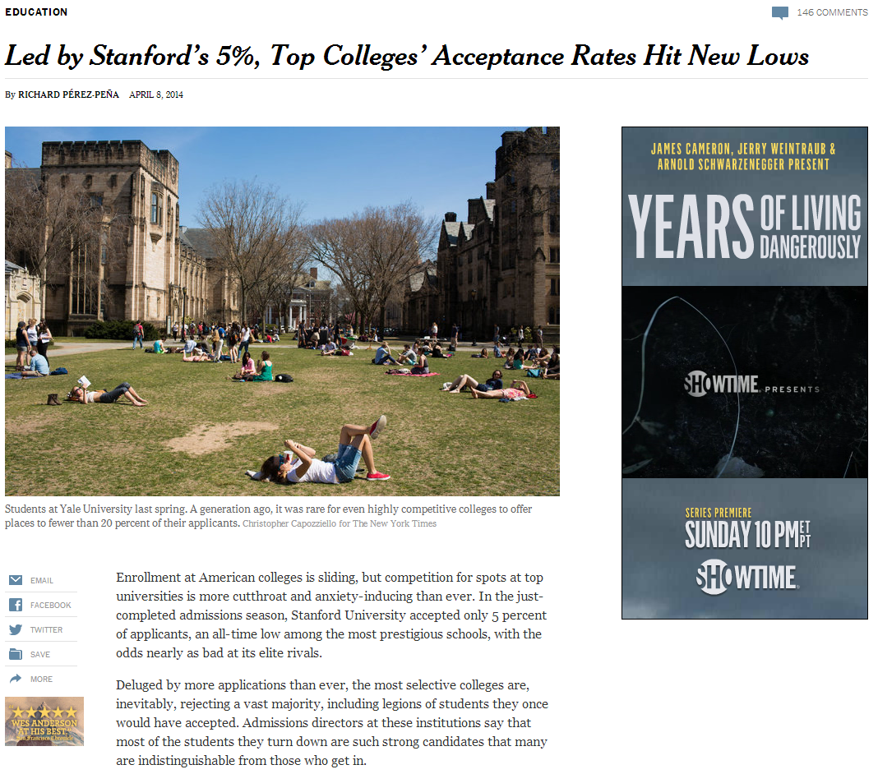
Congestion

Slide 36
Summary
Matching market differ widely in their degree of organization and centralization.
  Centralized markets generally try to coordinate matching on a particular date, and even markets such as US college admissions have fairly set dates for application, admission and decisions.
  The specific design of centralized markets – and ability to achieve stable outcomes – seems important for their success..
The timing and “orderliness” of market clearing can be a major issue driving attempts to organize markets
  In many cases, markets have exhibited a tendency to “unravel” in a disorderly way, potentially creating inefficiencies.
  In some cases, an “orderly” multi-stage market may be an efficient way to transmit information and limit transaction costs.
Notes:
36

